Slide 1
OOP

Slide 2
Common Magic Methods
In Python, we have a diverse range of magic methods – each serves its purpose. Here we will comb through, a few of the common magic methods:
Creation
Destruction
Type Conversion
Comparisons

Slide 3
Creation
Magic Methods entangled in creation, are performed when a class instance is created. Two of the magic methods associated are __init__ and __new__ methods.
The __init__ method of an object executes right away after the instance creation. Here, the method takes one positional argument – self – and any number of optional or keyword arguments. Let’s look into a simple example:
class InitClass(object):
def __init__(self):
print('Executing the __init__ method.')
instance = InitClass()
The __init__ method provides initial data to the object, not to create an object.
It only returns None; returning other than None raises TypeError.
It customizes the instantiation of a class.

Slide 4
Next, we will proceed to the __new__ method.
The __new__ method creates and returns the instance of a class. The primary argument of the __new__ method is the class that has to be instantiated, and the rest are the arguments mentioned during the class call. Let’s explore through an example:
class Students:
def __init__(self, idNo, grade):
self._idNo = idNo
self._grade = grade
def __new__(cls, idNo, grade):
print("Creating Instance")
instance = super().__new__(cls)
if 5 <= grade <= 10:
return instance
else:
return None

Slide 5
Output:
Creating Instance
Students({'_idNo': 1, '_grade': 7})
Creating Instance
None
In most cases, we do not need to define a __new__ method. If we go for a __new__ method implementation, then referencing the superclass is a must.
Another essential point to note, the __init__ method of the instantiated class get executes, only if the __new__ method returns an instance of the same class.

Slide 6
Destruction
The __del__ method is invoked on destroying an instance of a class – either through direct deletion or memory restoration by the garbage collector. Let’s examine the below code:
class MyClass:
def __del__(self):
print('Destroyed')
MyClass()
'Immutable String - not assigned to a variable'

Slide 7
Output
Destroyed
What happens when we create an object without assigning them to a variable?
The garbage collector will keep the record of objects, which is not referenced to a variable, and delete it when another program statement executes. Here, we created an object of MyClass without assigning it to a variable.
Upon execution of the program statement (Immutable String – not assigned to a variable), the garbage collector destroys the MyClass object.
The same happens, when we delete the object directly. But here the deletion happens immediately. Just try the below code.
x = MyClass()
del x

Slide 8
Type Conversion
Type Conversion refers to the conversion of one data type to another; Python provides several magic methods to handle the conversion.
__str__ method
__int__, __float__ and __complex__ methods
__bool__ method
__str__ method
The __str__ method requires one positional argument – self – and it returns a string. It is called when an object is passed to the str() constructor. Let’s consider an example:
class MyString:
def __str__(self):
return 'My String !'
print(str(MyString()))

Slide 9
Let’s take a look at another situation that invokes the __str__ method. The scenario is the usage of %s in a format string, which in turn invokes the __str__ method.
class HelloClass:
def __str__(self):
return 'George'
print('Hello, % s' % HelloClass())
Output
Hello, George

Slide 10
__int__, __float__ and __complex__ methods
The __int__ method executes upon calling the int constructor, and it returns an int; It converts the complex objects into primitive int type. Likewise, __float__ and _complex__ methods execute on passing the object to float and complex constructor, respectively.
__bool__ method
The __bool__ magic method in python takes one positional argument and returns either true or false. Its purpose is either to check an object is true or false, or to explicitly convert to a Boolean.

Slide 11
Comparisons
Comparisons magic methods are invoked, when we check for equivalence (==, !=) or relations (<, and > =). Each of this operator in python is mapped to its corresponding magic methods.
Binary Equality
1. __eq__ method
The __eq__ method executes when two objects are compared using == operator. It takes two positional arguments – the self, and the object to check the equality.
In most cases, if the object on the left side is defined, then its equivalence is checked first. Let’s see through an example:

Slide 12
class MyEquivalence:
def __eq__(self, other):
print('MyEquivalence:\n'
'% r\n % r' %(self, other))
return self is other
class YourEquivalence:
def __eq__(self, other):
print('Your Equivalence:\n'
'% r\n % r' %(self, other))
return self is other
eq1 = MyEquivalence()
eq2 = YourEquivalence()
# checking for equivalence where eq1 is at the left side
print(eq1 == eq2)
# checking for equivalence where eq2 is at the left side
print(eq2 == eq1)

Slide 13
Output
MyEquivalence:
<__main__.MyEquivalence object at 0x7fa1d38e16d8>
<__main__.YourEquivalence object at 0x7fa1d1ea37b8>
False
Your Equivalence:
<__main__.YourEquivalence object at 0x7fa1d1ea37b8>
<__main__.MyEquivalence object at 0x7fa1d38e16d8>
False

Slide 14
2. __ne__ method
The __ne__ magic method executes, when != operator is used. In most cases, we don’t need to define the __ne__ method; Upon using the != operator, the python interpreter will execute the __eq__ method and reverse the result.
Relative Comparisons – __lt__ & __le__, __gt__ & __ge__ methods
The __lt__ and __le__ methods are invoked when < and <= operators are used, respectively.And, the __gt__ and __ge__ methods are invoked on using > and >= operators, respectively. However, it’s not necessary to use all these 4 methods; usage of __lt__ and __gt__ methods will meet the purpose. Just examine the below points to understand why we don’t require all these methods:
1. The __ge__ and __le__ methods can be replaced with the inverse of __lt__ and __gt__ methods, respectively.
2. The disjunction of __lt__ and __eq__ methods can be used instead of the __le__ method, and similarly, the __gt__ and __eq__ methods for __ge__ method.
Let’s take a look at the below example. Here, we will compare the object based on its creation time.

Slide 15
import time
class ObjectCreationTime:
def __init__(self, objName):
self._created = time.time()
self._objName = objName
def __lt__(self, other):
print('Creation Time:\n'
'% s:% f\n % s:% f' %(self._objName, self._created,
other._objName, other._created))
return self._created < other._created
def __gt__(self, other):
print('Creation Time:\n'
'% s:% f\n % s:% f' %(self._objName, self._created,
other._objName, other._created))
return self._created > other._created
obj1 = ObjectCreationTime('obj1')
obj2 = ObjectCreationTime('obj2')
print(obj1 < obj2)
print(obj1 > obj2)

Slide 16
Output
Creation Time:
obj1:1590679265.753279
obj2:1590679265.753280
True
Creation Time:
obj1:1590679265.753279
obj2:1590679265.753280
False

Slide 17
Magic Methods for Unary Operators
__pos__ method
__neg__ method
__invert__ method
__pos__ method
The __pos__ method is invoked using the + operator. We have seen that + operator also functions as a binary operator. No worries, python interpreter knows which one to use – unary or binary – based on the situation.
The __pos__ method takes a single positional argument – self –, performs the operation, and returns the result. Let’s examine through an example:

Slide 18
class UnaryOp:
def __init__(self, value):
self._value = value
def __pos__(self):
print('__pos__ magic method')
return(+self._value)
up = UnaryOp(5)
print(+up)
Output
__pos__ magic method
5

Slide 19
__neg__ method
The __neg__ method is called using the – operator. This operator also acts as a binary operator but based on the situation the interpreter determines which magic method to map. The __neg__ magic method accepts a single positional argument – self –, operates and returns the result. Let’s check the below example:
class UnaryOp:
def __init__(self, value):
self._value = value
def __neg__(self):
print('__neg__ magic method')
return(-self._value)
up = UnaryOp(5)
print(-up)
Output
__neg__ magic method
-5

Slide 20
__invert__ method
The last unary operator is the __invert__ method, which is invoked using ~ operator. The statement ~x is equivalent to x.__invert__(). Let’s consider an example:
class InvertClass:
def __init__(self, value):
self._value = value
def __invert__(self):
return self._value[::-1]
def __str__(self):
return self._value
invrt = InvertClass('Hello, George')
invertedValue = ~invrt
print(invertedValue)
Output
egroeG, olleH

Slide 21
A Few Other Magic Methods
Let’s discuss about few other magic methods:
__len__ method
__repr__ method
__contains__ method
Overloading __len__ method
The len() method invokes the __len__ magic method. It takes one positional argument and returns the length of the object. Let’s see the below code:

Slide 22
class RectangleClass:
def __init__(self, area, breadth):
self._area = area
self._breadth = breadth
def __len__(self):
return int(self._area / self._breadth)
rc = RectangleClass(90, 5)
print(len(rc))

Slide 23
Importance of __repr__ method
The __repr__ magic method helps to represent an object in Python interactive terminal. It takes one positional argument – self.
Let’s have a look, how an object is represented in Python interactive terminal without overloading the __repr__ method.
## use python interactive terminal to check object representation.
RectangleClass(90, 5)
Output
<__main__.RectangleClass object at 0x7f9ecaae9710>

Slide 24
We can see, it returns the address of the object in the memory, which is not that useful.
Let’s look into how we can overload the __repr__ method to return a useful object representation.
Add:
def __repr__(self):
"""object representation"""
return 'RectangleClass(area =% d, breadth =% d)' %\
(self._area, self._breadth)
to our RectangleClass, then:
RectangleClass(90, 5)
RectangleClass(80, 4)

Slide 25
Output
RectangleClass(area=90, breadth=5)
RectangleClass(area=80, breadth=4)

Slide 26
Metaclasses
Abstract Base Classes (ABCs) ensure that derived classes implement
particular methods from the base class. In this chapter you’ll learn
about the benefits of abstract base classes and how to define them
with Python’s built-in abc module.
What they help for?
instantiating the base class is impossible
forgetting to implement interface methods in one of the subclasses raises an error as early as possible.

Slide 27
Now why would you want to use Python’s abc module to solve this problem?
To enforce that a derived class implements a number of methods from the base class, something like this Python idiom is typically used.
class Base:
def foo(self):
raise NotImplementedError()
def bar(self):
raise NotImplementedError()
class Concrete(Base):
def foo(self):
return "foo() called"
# Oh no, we forgot to override bar()...
# def bar(self):
# return "bar() called"

Slide 28
So, what do we get from this first attempt at solving the problem? Calling methods on an instance of Base correctly raises NotImplementedError exceptions:
b = Base()
b.foo()
Traceback (most recent call last):
File "/usr/lib/python3.8/code.py", line 90, in runcode
exec(code, self.locals)
File "<input>", line 19, in <module>
File "<input>", line 3, in foo
NotImplementedError

Slide 29
Furthermore, instantiating and using Concrete works as expected.
And, if we call an unimplemented method like bar() on it, this also
raises an exception:
c = Concrete()
print(c.foo())
c.bar()
foo() called
Traceback (most recent call last):
File "/usr/lib/python3.8/code.py", line 90, in runcode
exec(code, self.locals)
File "<input>", line 3, in <module>
File "<input>", line 6, in bar
NotImplementedError

Slide 30
This first implementation is decent, but it isn’t perfect yet. The down-
sides here are that we can still:
instantiate Base just fine without getting an error
provide incomplete subclasses—instantiating Concrete will not raise an error until we call the missing method bar() .
With Python’s abc module that was added in Python 2.6.4 we can do
better and solve these remaining issues. Here’s an updated implemen-
tation using an Abstract Base Class defined with the abc module:

Slide 31
from abc import ABCMeta, abstractmethod
class Base(metaclass=ABCMeta):
@abstractmethod
def foo(self):
pass
@abstractmethod
def bar(self):
pass
class Concrete(Base):
def foo(self):
pass
# We forgot to declare bar() again...

Slide 32
This still behaves as expected and creates the correct class hierarchy:
assert issubclass(Concrete, Base)
Yet, we do get another very useful benefit here. Subclasses of Base
raise a TypeError at instantiation time whenever we forget to im-
plement any abstract methods. The raised exception tells us which
method or methods we’re missing:
c = Concrete()
Traceback (most recent call last):
File "/usr/lib/python3.8/code.py", line 90, in runcode
exec(code, self.locals)
File "<input>", line 23, in <module>
TypeError: Can't instantiate abstract class Concrete with abstract methods bar

Slide 33
Without abc , we’d only get a NotImplementedError if a missing
method was actually called.
Being notified about missing methods at instantiation time is a great advantage.
It makes it more difficult to write invalid subclasses. This might not be a big deal if you’re writing new code, but a few weeks or months down the line, I promise it’ll be helpful.

Slide 34
SOLID principles
The Single Responsibility Principle
The Open-Closed Principle
The Liskov Substitution Principle
The Interface Segregation Principle
The Dependency Inversion Principle

Slide 35
The Single Responsibility Principle
The Single Responsibility Principle states that a class should do one thing and therefore it should have only a single reason to change.

Slide 36
Open-Closed Principle
The Open-Closed Principle requires that classes should be open for extension and closed to modification.

Slide 37
Liskov Substitution Principle
The Liskov Substitution Principle states that subclasses should be substitutable for their base classes.

Slide 38
Interface Segregation Principle
Segregation means keeping things separated, and the Interface Segregation Principle is about separating the interfaces.

Slide 39
Dependency Inversion Principle
The Dependency Inversion principle states that our classes should depend upon interfaces or abstract classes instead of concrete classes and functions.

Slide 40
Design patterns
Object-oriented design patterns are ideas of software construction that appear
in different scenarios when we deal with models of the problem we're solving.
Because they're high-level ideas, it's hard to think of them as being tied to particular
programming languages.
They are instead more general concepts about how objects will interact in the application.
Of course, they will have their implementation details, varying from language to language, but that doesn't form the essence of a design pattern.

Slide 41
Creational patterns
Factory
Abstract factory
Singleton and shared state (monostate)
Builder
Prototype
Structural patterns
Adapter
Bridge
Composite
Decorator
Facade
Flyweight
Proxy
Behavioral patterns
Chain of responsibility
The template method
Command
State
Iterator
Mediator
Memento
Observer
Strategy
Visitor

Slide 42
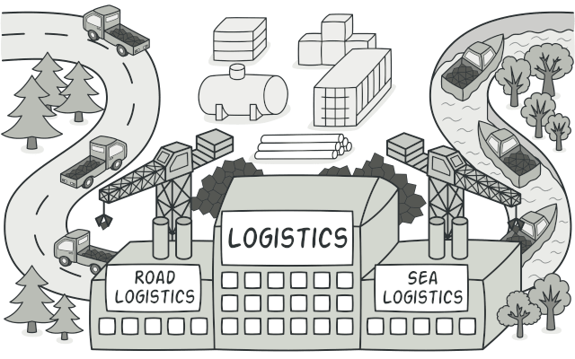
Creational patterns
Factories
Intent:
Factory Method is a creational design pattern that provides an interface for creating objects in a superclass, but allows subclasses to alter the type of objects that will be created.

Slide 43
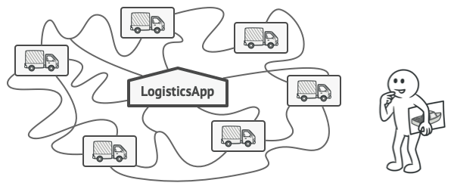
Problem
Imagine that you’re creating a logistics management application. The first version of your app can only handle transportation by trucks, so the bulk of your code lives inside the Truck class.
After a while, your app becomes pretty popular. Each day you receive dozens of requests from sea transportation companies to incorporate sea logistics into the app.
Adding a new class to the program isn’t that simple if the rest of the code is already coupled to existing classes.

Slide 44
Great news, right? But how about the code? At present, most of your code is coupled to the Truck class. Adding Ships into the app would require making changes to the entire codebase. Moreover, if later you decide to add another type of transportation to the app, you will probably need to make all of these changes again.
As a result, you will end up with pretty nasty code, riddled with conditionals that switch the app’s behavior depending on the class of transportation objects.

Slide 45
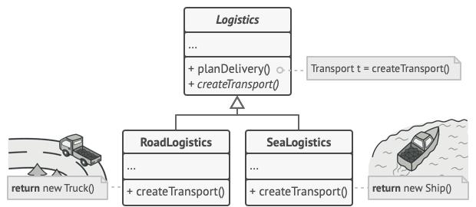
Solution
The Factory Method pattern suggests that you replace direct object construction calls (using the new operator) with calls to a special factory method. Don’t worry: the objects are still created via the new operator, but it’s being called from within the factory method. Objects returned by a factory method are often referred to as products.
Subclasses can alter the class of objects being returned by the factory method.

Slide 46
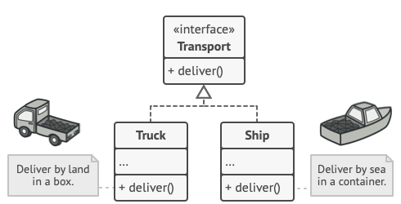
At first glance, this change may look pointless: we just moved the constructor call from one part of the program to another. However, consider this: now you can override the factory method in a subclass and change the class of products being created by the method.
There’s a slight limitation though: subclasses may return different types of products only if these products have a common base class or interface. Also, the factory method in the base class should have its return type declared as this interface.
All products must follow the same interface.

Slide 47
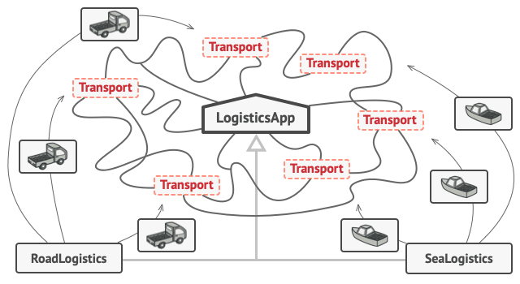
For example, both Truck and Ship classes should implement the Transport interface, which declares a method called deliver. Each class implements this method differently: trucks deliver cargo by land, ships deliver cargo by sea. The factory method in the RoadLogistics class returns truck objects, whereas the factory method in the SeaLogistics class returns ships.
As long as all product classes implement a common interface, you can pass their objects to the client code without breaking it.

Slide 48
The code that uses the factory method (often called the client code) doesn’t see a difference between the actual products returned by various subclasses. The client treats all the products as abstract Transport. The client knows that all transport objects are supposed to have the deliver method, but exactly how it works isn’t important to the client.

Slide 49
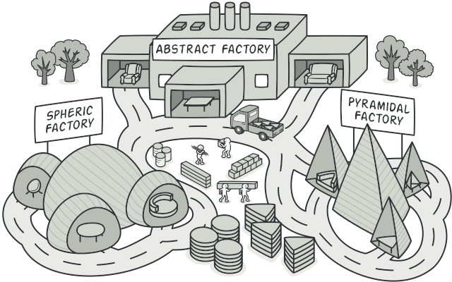
Abstract Factory
Intent
Abstract Factory is a creational design pattern that lets you produce families of related objects without specifying their concrete classes.

Slide 50
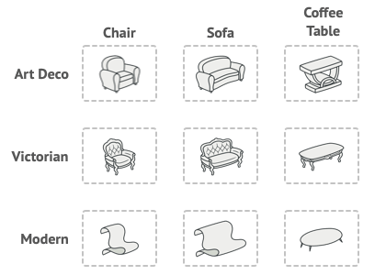
Problem
Imagine that you’re creating a furniture shop simulator. Your code consists of classes that represent:
A family of related products, say: Chair + Sofa + CoffeeTable.
Several variants of this family. For example, products Chair + Sofa + CoffeeTable are available in these variants: Modern, Victorian, ArtDeco.
Product families and their variants.

Slide 51
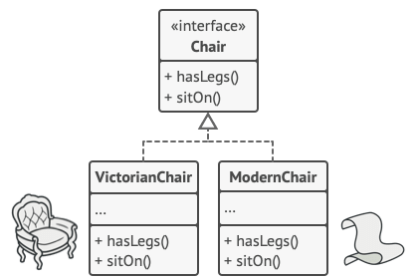
Solution
The first thing the Abstract Factory pattern suggests is to explicitly declare interfaces for each distinct product of the product family (e.g., chair, sofa or coffee table). Then you can make all variants of products follow those interfaces. For example, all chair variants can implement the Chair interface; all coffee table variants can implement the CoffeeTable interface, and so on.
All variants of the same object must be moved to a single class hierarchy.

Slide 52
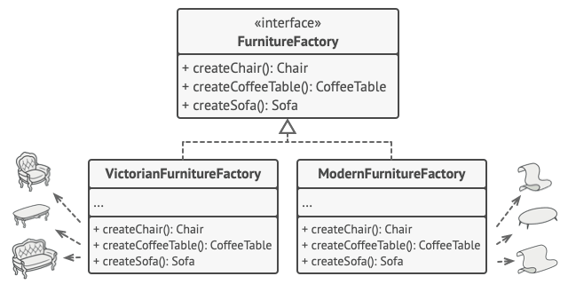
The next move is to declare the Abstract Factory—an interface with a list of creation methods for all products that are part of the product family (for example, createChair, createSofa and createCoffeeTable). These methods must return abstract product types represented by the interfaces we extracted previously: Chair, Sofa, CoffeeTable and so on.
Each concrete factory corresponds to a specific product variant.

Slide 53
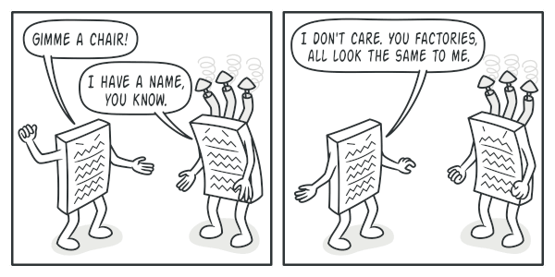
Now, how about the product variants? For each variant of a product family, we create a separate factory class based on the AbstractFactory interface. A factory is a class that returns products of a particular kind. For example, the ModernFurnitureFactory can only create ModernChair, ModernSofa and ModernCoffeeTable objects.
The client code has to work with both factories and products via their respective abstract interfaces. This lets you change the type of a factory that you pass to the client code, as well as the product variant that the client code receives, without breaking the actual client code.
The client shouldn’t care about the concrete class of the factory it works with.

Slide 54
Say the client wants a factory to produce a chair. The client doesn’t have to be aware of the factory’s class, nor does it matter what kind of chair it gets. Whether it’s a Modern model or a Victorian-style chair, the client must treat all chairs in the same manner, using the abstract Chair interface. With this approach, the only thing that the client knows about the chair is that it implements the sitOn method in some way. Also, whichever variant of the chair is returned, it’ll always match the type of sofa or coffee table produced by the same factory object.
There’s one more thing left to clarify: if the client is only exposed to the abstract interfaces, what creates the actual factory objects? Usually, the application creates a concrete factory object at the initialization stage. Just before that, the app must select the factory type depending on the configuration or the environment settings.

Slide 55
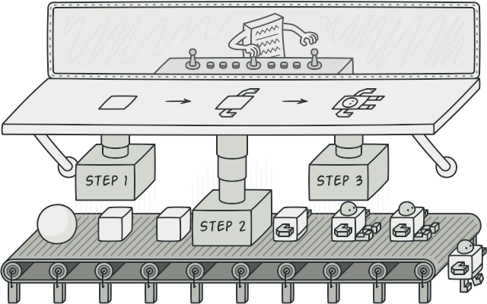
Builder
Intent
Builder is a creational design pattern that lets you construct complex objects step by step. The pattern allows you to produce different types and representations of an object using the same construction code.

Slide 56
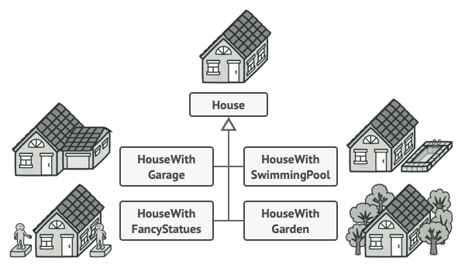
Problem
Imagine a complex object that requires laborious, step-by-step initialization of many fields and nested objects. Such initialization code is usually buried inside a monstrous constructor with lots of parameters. Or even worse: scattered all over the client code.
You might make the program too complex by creating a subclass for every possible configuration of an object.

Slide 57
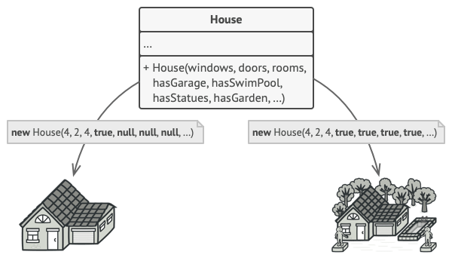
For example, let’s think about how to create a House object. To build a simple house, you need to construct four walls and a floor, install a door, fit a pair of windows, and build a roof. But what if you want a bigger, brighter house, with a backyard and other goodies (like a heating system, plumbing, and electrical wiring)?
The simplest solution is to extend the base House class and create a set of subclasses to cover all combinations of the parameters. But eventually you’ll end up with a considerable number of subclasses. Any new parameter, such as the porch style, will require growing this hierarchy even more.
There’s another approach that doesn’t involve breeding subclasses. You can create a giant constructor right in the base House class with all possible parameters that control the house object. While this approach indeed eliminates the need for subclasses, it creates another problem.
The constructor with lots of parameters has its downside: not all the parameters are needed at all times.

Slide 58
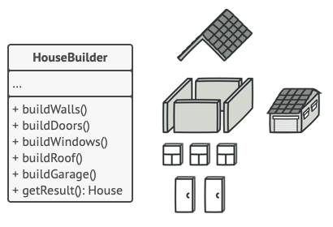
Solution
The Builder pattern suggests that you extract the object construction code out of its own class and move it to separate objects called builders.
The Builder pattern lets you construct complex objects step by step. The Builder doesn’t allow other objects to access the product while it’s being built.

Slide 59
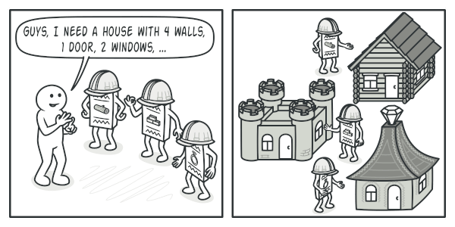
The pattern organizes object construction into a set of steps (buildWalls, buildDoor, etc.). To create an object, you execute a series of these steps on a builder object. The important part is that you don’t need to call all of the steps. You can call only those steps that are necessary for producing a particular configuration of an object.
Some of the construction steps might require different implementation when you need to build various representations of the product. For example, walls of a cabin may be built of wood, but the castle walls must be built with stone.
In this case, you can create several different builder classes that implement the same set of building steps, but in a different manner. Then you can use these builders in the construction process (i.e., an ordered set of calls to the building steps) to produce different kinds of objects.
Different builders execute the same task in various ways.

Slide 60
For example, imagine a builder that builds everything from wood and glass, a second one that builds everything with stone and iron and a third one that uses gold and diamonds. By calling the same set of steps, you get a regular house from the first builder, a small castle from the second and a palace from the third. However, this would only work if the client code that calls the building steps is able to interact with builders using a common interface.

Slide 61
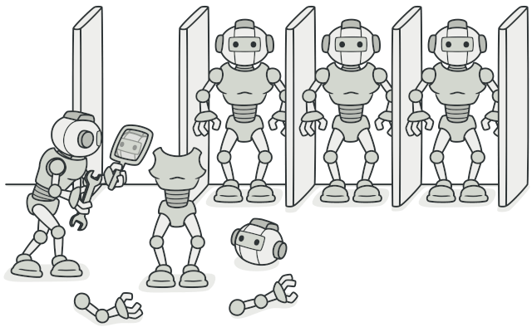
Prototype
Intent
Prototype is a creational design pattern that lets you copy existing objects without making your code dependent on their classes.

Slide 62

Problem
Say you have an object, and you want to create an exact copy of it. How would you do it? First, you have to create a new object of the same class. Then you have to go through all the fields of the original object and copy their values over to the new object.
Nice! But there’s a catch. Not all objects can be copied that way because some of the object’s fields may be private and not visible from outside of the object itself.
Copying an object “from the outside” isn’t always possible.

Slide 63
There’s one more problem with the direct approach. Since you have to know the object’s class to create a duplicate, your code becomes dependent on that class. If the extra dependency doesn’t scare you, there’s another catch. Sometimes you only know the interface that the object follows, but not its concrete class, when, for example, a parameter in a method accepts any objects that follow some interface.

Slide 64
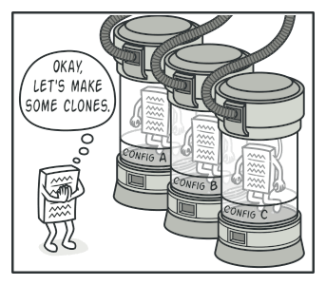
Solution
The Prototype pattern delegates the cloning process to the actual objects that are being cloned. The pattern declares a common interface for all objects that support cloning. This interface lets you clone an object without coupling your code to the class of that object. Usually, such an interface contains just a single clone method.
The implementation of the clone method is very similar in all classes. The method creates an object of the current class and carries over all of the field values of the old object into the new one. You can even copy private fields because most programming languages let objects access private fields of other objects that belong to the same class.
An object that supports cloning is called a prototype. When your objects have dozens of fields and hundreds of possible configurations, cloning them might serve as an alternative to subclassing.
Pre-built prototypes can be an alternative to subclassing.

Slide 65
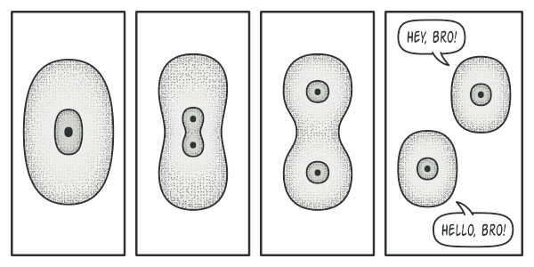
Here’s how it works: you create a set of objects, configured in various ways. When you need an object like the one you’ve configured, you just clone a prototype instead of constructing a new object from scratch.
Real-World Analogy
In real life, prototypes are used for performing various tests before starting mass production of a product. However, in this case, prototypes don’t participate in any actual production, playing a passive role instead.
The division of a cell.

Slide 66
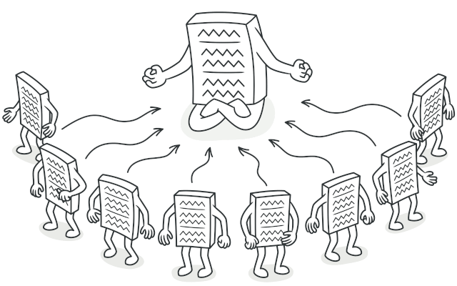
Singleton
Intent
Singleton is a creational design pattern that lets you ensure that a class has only one instance, while providing a global access point to this instance.

Slide 67
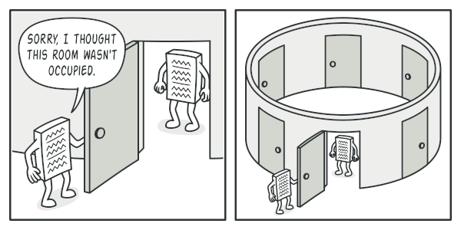
Problem
The Singleton pattern solves two problems at the same time, violating the Single Responsibility Principle:
Ensure that a class has just a single instance. Why would anyone want to control how many instances a class has? The most common reason for this is to control access to some shared resource—for example, a database or a file. Here’s how it works: imagine that you created an object, but after a while decided to create a new one. Instead of receiving a fresh object, you’ll get the one you already created. Note that this behavior is impossible to implement with a regular constructor since a constructor call must always return a new object by design.
Clients may not even realize that they’re working with the same object all the time.

Slide 68
Provide a global access point to that instance. Remember those global variables that you (all right, me) used to store some essential objects? While they’re very handy, they’re also very unsafe since any code can potentially overwrite the contents of those variables and crash the app. Just like a global variable, the Singleton pattern lets you access some object from anywhere in the program. However, it also protects that instance from being overwritten by other code. There’s another side to this problem: you don’t want the code that solves problem #1 to be scattered all over your program. It’s much better to have it within one class, especially if the rest of your code already depends on it.
Nowadays, the Singleton pattern has become so popular that people may call something a singleton even if it solves just one of the listed problems.

Slide 69
Solution
All implementations of the Singleton have these two steps in common:
Make the default constructor private, to prevent other objects from using the new operator with the Singleton class.
Create a static creation method that acts as a constructor. Under the hood, this method calls the private constructor to create an object and saves it in a static field. All following calls to this method return the cached object.
If your code has access to the Singleton class, then it’s able to call the Singleton’s static method. So whenever that method is called, the same object is always returned.

Slide 70
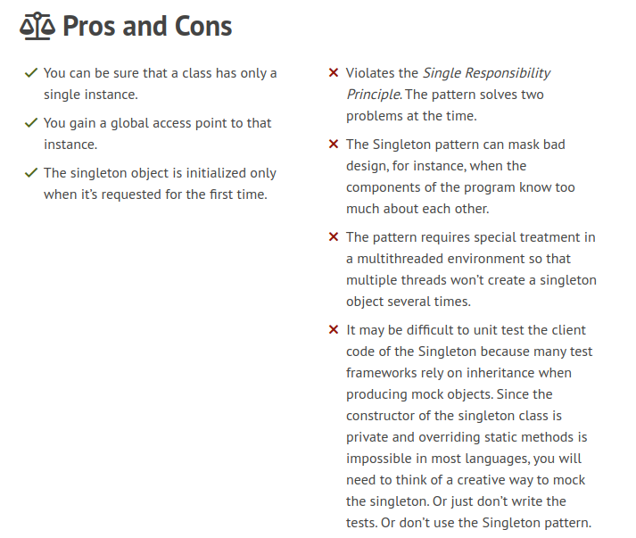

Slide 71
Structural Design Patterns
Structural patterns
Adapter
Bridge
Composite
Decorator
Facade
Flyweight
Proxy

Slide 72
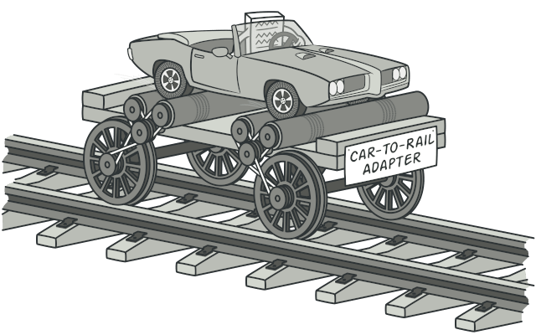
Adapter
Intent
Adapter is a structural design pattern that allows objects with incompatible interfaces to collaborate.

Slide 73
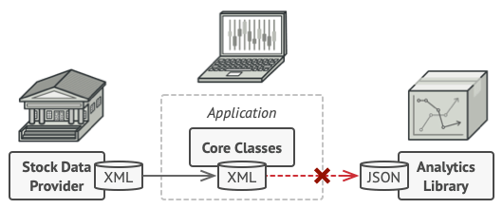
Problem
Imagine that you’re creating a stock market monitoring app. The app downloads the stock data from multiple sources in XML format and then displays nice-looking charts and diagrams for the user.
At some point, you decide to improve the app by integrating a smart 3rd-party analytics library. But there’s a catch: the analytics library only works with data in JSON format.
You can’t use the analytics library “as is” because it expects the data in a format that’s incompatible with your app.

Slide 74
You could change the library to work with XML. However, this might break some existing code that relies on the library. And worse, you might not have access to the library’s source code in the first place, making this approach impossible.

Slide 75
Solution
You can create an adapter. This is a special object that converts the interface of one object so that another object can understand it.
An adapter wraps one of the objects to hide the complexity of conversion happening behind the scenes. The wrapped object isn’t even aware of the adapter. For example, you can wrap an object that operates in meters and kilometers with an adapter that converts all of the data to imperial units such as feet and miles.
Adapters can not only convert data into various formats but can also help objects with different interfaces collaborate. Here’s how it works:
The adapter gets an interface, compatible with one of the existing objects.
Using this interface, the existing object can safely call the adapter’s methods.
Upon receiving a call, the adapter passes the request to the second object, but in a format and order that the second object expects.
Sometimes it’s even possible to create a two-way adapter that can convert the calls in both directions.

Slide 76
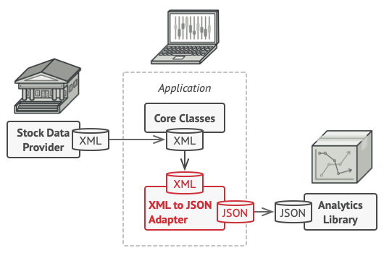
Let’s get back to our stock market app. To solve the dilemma of incompatible formats, you can create XML-to-JSON adapters for every class of the analytics library that your code works with directly. Then you adjust your code to communicate with the library only via these adapters. When an adapter receives a call, it translates the incoming XML data into a JSON structure and passes the call to the appropriate methods of a wrapped analytics object.

Slide 77
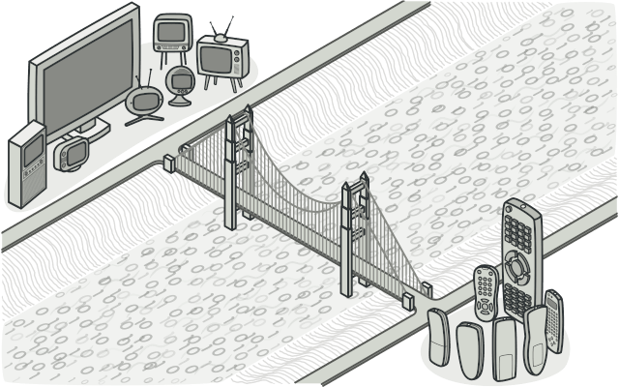
Bridge
Intent
Bridge is a structural design pattern that lets you split a large class or a set of closely related classes into two separate hierarchies—abstraction and implementation—which can be developed independently of each other.

Slide 78
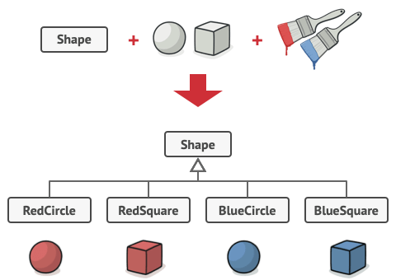
Problem
Abstraction? Implementation? Sound scary? Stay calm and let’s consider a simple example.
Say you have a geometric Shape class with a pair of subclasses: Circle and Square. You want to extend this class hierarchy to incorporate colors, so you plan to create Red and Blue shape subclasses. However, since you already have two subclasses, you’ll need to create four class combinations such as BlueCircle and RedSquare.
Number of class combinations grows in geometric progression.

Slide 79
Adding new shape types and colors to the hierarchy will grow it exponentially. For example, to add a triangle shape you’d need to introduce two subclasses, one for each color. And after that, adding a new color would require creating three subclasses, one for each shape type. The further we go, the worse it becomes.

Slide 80
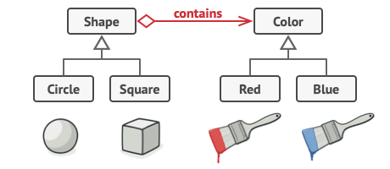
Solution
This problem occurs because we’re trying to extend the shape classes in two independent dimensions: by form and by color. That’s a very common issue with class inheritance.
The Bridge pattern attempts to solve this problem by switching from inheritance to the object composition. What this means is that you extract one of the dimensions into a separate class hierarchy, so that the original classes will reference an object of the new hierarchy, instead of having all of its state and behaviors within one class.
You can prevent the explosion of a class hierarchy by transforming it into several related hierarchies.

Slide 81
Following this approach, we can extract the color-related code into its own class with two subclasses: Red and Blue. The Shape class then gets a reference field pointing to one of the color objects. Now the shape can delegate any color-related work to the linked color object. That reference will act as a bridge between the Shape and Color classes. From now on, adding new colors won’t require changing the shape hierarchy, and vice versa.

Slide 82

Composite
Intent
Composite is a structural design pattern that lets you compose objects into tree structures and then work with these structures as if they were individual objects.

Slide 83
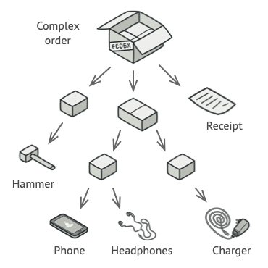
Problem
Using the Composite pattern makes sense only when the core model of your app can be represented as a tree.
For example, imagine that you have two types of objects: Products and Boxes. A Box can contain several Products as well as a number of smaller Boxes. These little Boxes can also hold some Products or even smaller Boxes, and so on.
Say you decide to create an ordering system that uses these classes. Orders could contain simple products without any wrapping, as well as boxes stuffed with products...and other boxes. How would you determine the total price of such an order?
An order might comprise various products, packaged in boxes, which are packaged in bigger boxes and so on. The whole structure looks like an upside down tree.

Slide 84
You could try the direct approach: unwrap all the boxes, go over all the products and then calculate the total. That would be doable in the real world; but in a program, it’s not as simple as running a loop. You have to know the classes of Products and Boxes you’re going through, the nesting level of the boxes and other nasty details beforehand. All of this makes the direct approach either too awkward or even impossible.

Slide 85
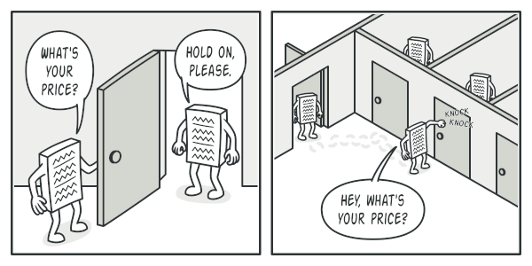
Solution
The Composite pattern suggests that you work with Products and Boxes through a common interface which declares a method for calculating the total price.
How would this method work? For a product, it’d simply return the product’s price. For a box, it’d go over each item the box contains, ask its price and then return a total for this box. If one of these items were a smaller box, that box would also start going over its contents and so on, until the prices of all inner components were calculated. A box could even add some extra cost to the final price, such as packaging cost.
The Composite pattern lets you run a behavior recursively over all components of an object tree.

Slide 86
The greatest benefit of this approach is that you don’t need to care about the concrete classes of objects that compose the tree. You don’t need to know whether an object is a simple product or a sophisticated box. You can treat them all the same via the common interface. When you call a method, the objects themselves pass the request down the tree.

Slide 87
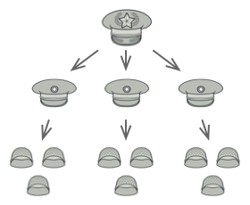
Real-World Analogy
An example of a military structure.
Armies of most countries are structured as hierarchies. An army consists of several divisions; a division is a set of brigades, and a brigade consists of platoons, which can be broken down into squads. Finally, a squad is a small group of real soldiers. Orders are given at the top of the hierarchy and passed down onto each level until every soldier knows what needs to be done.

Slide 88
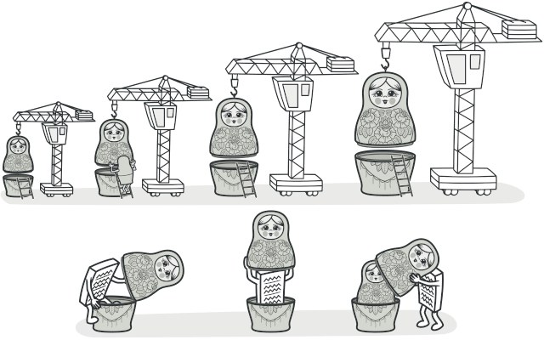
Decorator
Intent
Decorator is a structural design pattern that lets you attach new behaviors to objects by placing these objects inside special wrapper objects that contain the behaviors.

Slide 89
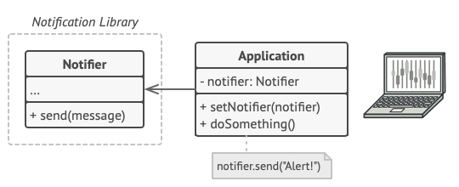
Problem
Imagine that you’re working on a notification library which lets other programs notify their users about important events.
The initial version of the library was based on the Notifier class that had only a few fields, a constructor and a single send method. The method could accept a message argument from a client and send the message to a list of emails that were passed to the notifier via its constructor. A third-party app which acted as a client was supposed to create and configure the notifier object once, and then use it each time something important happened.
A program could use the notifier class to send notifications about important events to a predefined set of emails.

Slide 90
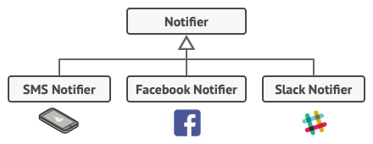
At some point, you realize that users of the library expect more than just email notifications. Many of them would like to receive an SMS about critical issues. Others would like to be notified on Facebook and, of course, the corporate users would love to get Slack notifications.
Each notification type is implemented as a notifier’s subclass.

Slide 91
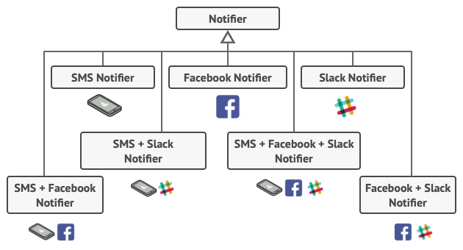
How hard can that be? You extended the Notifier class and put the additional notification methods into new subclasses. Now the client was supposed to instantiate the desired notification class and use it for all further notifications.
But then someone reasonably asked you, “Why can’t you use several notification types at once? If your house is on fire, you’d probably want to be informed through every channel.”
You tried to address that problem by creating special subclasses which combined several notification methods within one class. However, it quickly became apparent that this approach would bloat the code immensely, not only the library code but the client code as well.
Combinatorial explosion of subclasses.
You have to find some other way to structure notifications classes so that their number won’t accidentally break some Guinness record.

Slide 92
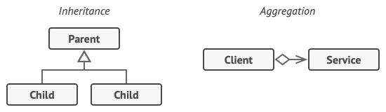
Solution
Extending a class is the first thing that comes to mind when you need to alter an object’s behavior. However, inheritance has several serious caveats that you need to be aware of.
Inheritance is static. You can’t alter the behavior of an existing object at runtime. You can only replace the whole object with another one that’s created from a different subclass.
Subclasses can have just one parent class. In most languages, inheritance doesn’t let a class inherit behaviors of multiple classes at the same time.
One of the ways to overcome these caveats is by using Aggregation or Composition instead of Inheritance. Both of the alternatives work almost the same way: one object has a reference to another and delegates it some work, whereas with inheritance, the object itself is able to do that work, inheriting the behavior from its superclass.
With this new approach you can easily substitute the linked “helper” object with another, changing the behavior of the container at runtime. An object can use the behavior of various classes, having references to multiple objects and delegating them all kinds of work. Aggregation/composition is the key principle behind many design patterns, including Decorator. On that note, let’s return to the pattern discussion.

Slide 93
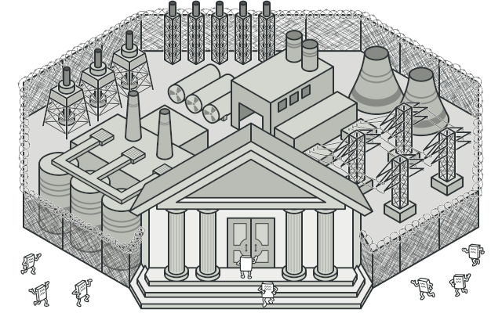
Facade
Intent
Facade is a structural design pattern that provides a simplified interface to a library, a framework, or any other complex set of classes.

Slide 94
Problem
Imagine that you must make your code work with a broad set of objects that belong to a sophisticated library or framework. Ordinarily, you’d need to initialize all of those objects, keep track of dependencies, execute methods in the correct order, and so on.
As a result, the business logic of your classes would become tightly coupled to the implementation details of 3rd-party classes, making it hard to comprehend and maintain.

Slide 95
Solution
A facade is a class that provides a simple interface to a complex subsystem which contains lots of moving parts. A facade might provide limited functionality in comparison to working with the subsystem directly. However, it includes only those features that clients really care about.
Having a facade is handy when you need to integrate your app with a sophisticated library that has dozens of features, but you just need a tiny bit of its functionality.
For instance, an app that uploads short funny videos with cats to social media could potentially use a professional video conversion library. However, all that it really needs is a class with the single method encode(filename, format). After creating such a class and connecting it with the video conversion library, you’ll have your first facade.

Slide 96
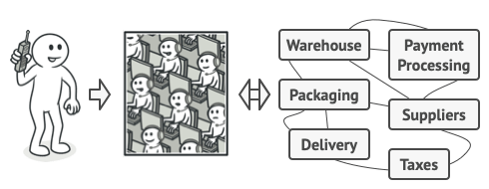
Real live Analogy
Placing orders by phone.
When you call a shop to place a phone order, an operator is your facade to all services and departments of the shop. The operator provides you with a simple voice interface to the ordering system, payment gateways, and various delivery services.

Slide 97
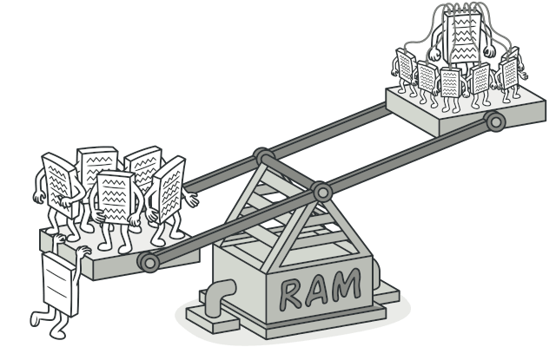
Flyweight
Intent
Flyweight is a structural design pattern that lets you fit more objects into the available amount of RAM by sharing common parts of state between multiple objects instead of keeping all of the data in each object.

Slide 98
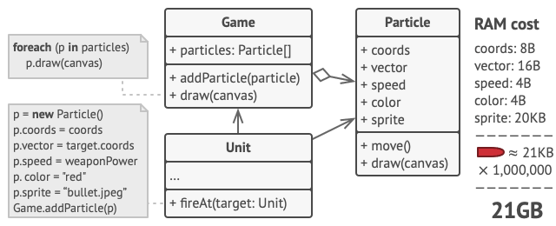
Problem
To have some fun after long working hours, you decided to create a simple video game: players would be moving around a map and shooting each other. You chose to implement a realistic particle system and make it a distinctive feature of the game. Vast quantities of bullets, missiles, and shrapnel from explosions should fly all over the map and deliver a thrilling experience to the player.
Upon its completion, you pushed the last commit, built the game and sent it to your friend for a test drive. Although the game was running flawlessly on your machine, your friend wasn’t able to play for long. On his computer, the game kept crashing after a few minutes of gameplay. After spending several hours digging through debug logs, you discovered that the game crashed because of an insufficient amount of RAM. It turned out that your friend’s rig was much less powerful than your own computer, and that’s why the problem emerged so quickly on his machine.
The actual problem was related to your particle system. Each particle, such as a bullet, a missile or a piece of shrapnel was represented by a separate object containing plenty of data. At some point, when the carnage on a player’s screen reached its climax, newly created particles no longer fit into the remaining RAM, so the program crashed.

Slide 99
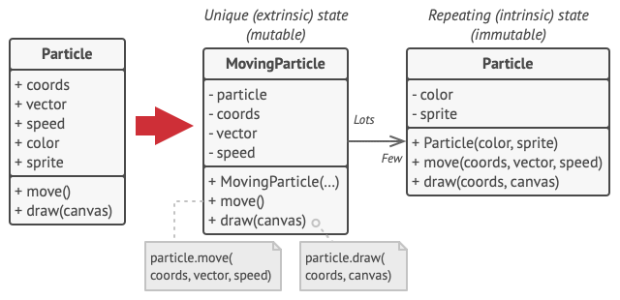
Solution
On closer inspection of the Particle class, you may notice that the color and sprite fields consume a lot more memory than other fields. What’s worse is that these two fields store almost identical data across all particles. For example, all bullets have the same color and sprite.

Slide 100
Other parts of a particle’s state, such as coordinates, movement vector and speed, are unique to each particle. After all, the values of these fields change over time. This data represents the always changing context in which the particle exists, while the color and sprite remain constant for each particle.
This constant data of an object is usually called the intrinsic state. It lives within the object; other objects can only read it, not change it. The rest of the object’s state, often altered “from the outside” by other objects, is called the extrinsic state.
The Flyweight pattern suggests that you stop storing the extrinsic state inside the object. Instead, you should pass this state to specific methods which rely on it. Only the intrinsic state stays within the object, letting you reuse it in different contexts. As a result, you’d need fewer of these objects since they only differ in the intrinsic state, which has much fewer variations than the extrinsic.

Slide 101
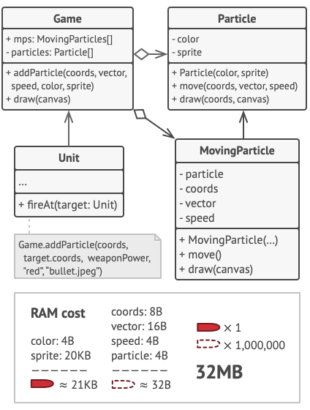

Slide 102
Let’s return to our game. Assuming that we had extracted the extrinsic state from our particle class, only three different objects would suffice to represent all particles in the game: a bullet, a missile, and a piece of shrapnel. As you’ve probably guessed by now, an object that only stores the intrinsic state is called a flyweight.

Slide 103
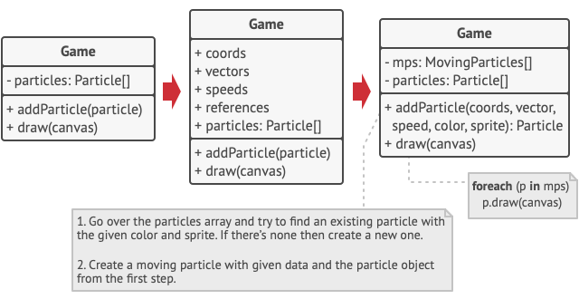
Extrinsic state storage
Where does the extrinsic state move to? Some class should still store it, right? In most cases, it gets moved to the container object, which aggregates objects before we apply the pattern.
In our case, that’s the main Game object that stores all particles in the particles field. To move the extrinsic state into this class, you need to create several array fields for storing coordinates, vectors, and speed of each individual particle. But that’s not all. You need another array for storing references to a specific flyweight that represents a particle. These arrays must be in sync so that you can access all data of a particle using the same index.

Slide 104
Flyweight and immutability
Since the same flyweight object can be used in different contexts, you have to make sure that its state can’t be modified. A flyweight should initialize its state just once, via constructor parameters. It shouldn’t expose any setters or public fields to other objects.
Flyweight factory
For more convenient access to various flyweights, you can create a factory method that manages a pool of existing flyweight objects. The method accepts the intrinsic state of the desired flyweight from a client, looks for an existing flyweight object matching this state, and returns it if it was found. If not, it creates a new flyweight and adds it to the pool.
There are several options where this method could be placed. The most obvious place is a flyweight container. Alternatively, you could create a new factory class. Or you could make the factory method static and put it inside an actual flyweight class.

Slide 105
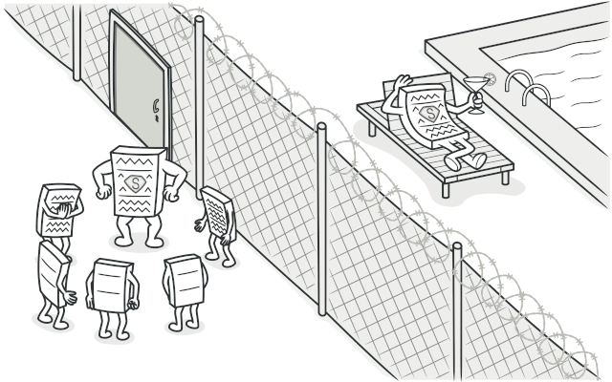
Proxy
Intent
Proxy is a structural design pattern that lets you provide a substitute or placeholder for another object. A proxy controls access to the original object, allowing you to perform something either before or after the request gets through to the original object.

Slide 106
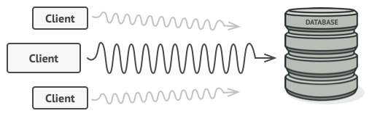
Problem
Why would you want to control access to an object? Here is an example: you have a massive object that consumes a vast amount of system resources. You need it from time to time, but not always.
You could implement lazy initialization: create this object only when it’s actually needed. All of the object’s clients would need to execute some deferred initialization code. Unfortunately, this would probably cause a lot of code duplication.
In an ideal world, we’d want to put this code directly into our object’s class, but that isn’t always possible. For instance, the class may be part of a closed 3rd-party library.

Slide 107
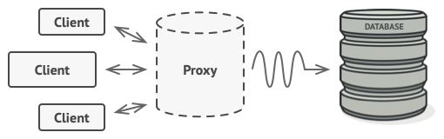
Solution
The Proxy pattern suggests that you create a new proxy class with the same interface as an original service object. Then you update your app so that it passes the proxy object to all of the original object’s clients. Upon receiving a request from a client, the proxy creates a real service object and delegates all the work to it.
The proxy disguises itself as a database object. It can handle lazy initialization and result caching without the client or the real database object even knowing.
But what’s the benefit? If you need to execute something either before or after the primary logic of the class, the proxy lets you do this without changing that class. Since the proxy implements the same interface as the original class, it can be passed to any client that expects a real service object.

Slide 108
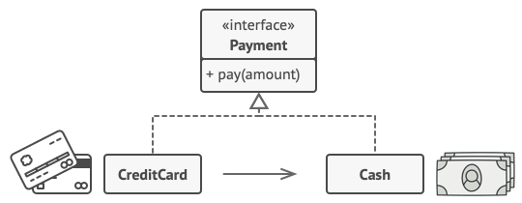
Real live Analogy
A credit card is a proxy for a bank account, which is a proxy for a bundle of cash. Both implement the same interface: they can be used for making a payment. A consumer feels great because there’s no need to carry loads of cash around. A shop owner is also happy since the income from a transaction gets added electronically to the shop’s bank account without the risk of losing the deposit or getting robbed on the way to the bank.

Slide 109
Behavioral patterns
Chain of responsibility
The template method
Command
State
Iterator
Mediator
Memento
Observer
Strategy
Visitor

Slide 110
Chain of responsibility
Intent
Chain of Responsibility is a behavioral design pattern that lets you pass requests along a chain of handlers. Upon receiving a request, each handler decides either to process the request or to pass it to the next handler in the chain.
Example: Authentication system

Slide 111
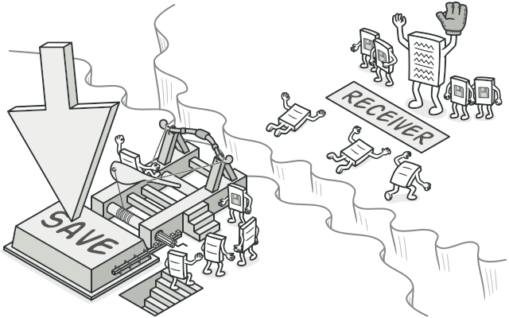
Command
Intent
Command is a behavioral design pattern that turns a request into a stand-alone object that contains all information about the request. This transformation lets you pass requests as a method arguments, delay or queue a request’s execution, and support undoable operations.

Slide 112
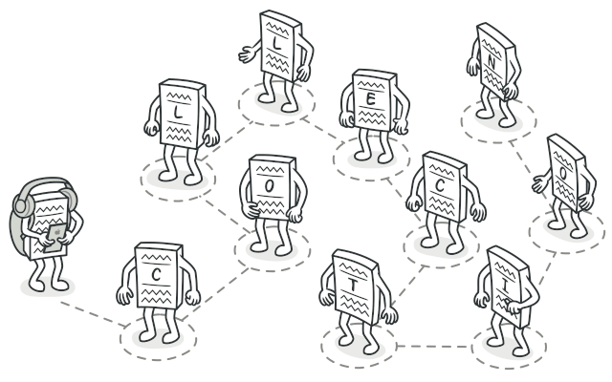
Iterator
Intent
Iterator is a behavioral design pattern that lets you traverse elements of a collection without exposing its underlying representation (list, stack, tree, etc.).

Slide 113
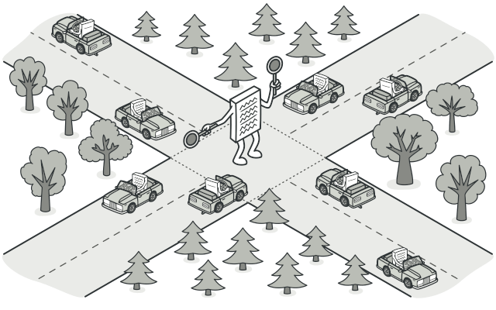
Mediator
Intent
Mediator is a behavioral design pattern that lets you reduce chaotic dependencies between objects. The pattern restricts direct communications between the objects and forces them to collaborate only via a mediator object.

Slide 114
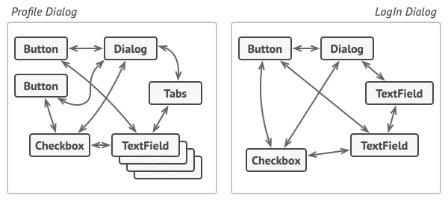
Problem
Say you have a dialog for creating and editing customer profiles. It consists of various form controls such as text fields, checkboxes, buttons, etc.

Slide 115

Some of the form elements may interact with others. For instance, selecting the “I have a dog” checkbox may reveal a hidden text field for entering the dog’s name. Another example is the submit button that has to validate values of all fields before saving the data.
Elements can have lots of relations with other elements. Hence, changes to some elements may affect the others.
By having this logic implemented directly inside the code of the form elements you make these elements’ classes much harder to reuse in other forms of the app. For example, you won’t be able to use that checkbox class inside another form, because it’s coupled to the dog’s text field. You can use either all the classes involved in rendering the profile form, or none at all.

Slide 116

Solution
The Mediator pattern suggests that you should cease all direct communication between the components which you want to make independent of each other. Instead, these components must collaborate indirectly, by calling a special mediator object that redirects the calls to appropriate components. As a result, the components depend only on a single mediator class instead of being coupled to dozens of their colleagues.
In our example with the profile editing form, the dialog class itself may act as the mediator. Most likely, the dialog class is already aware of all of its sub-elements, so you won’t even need to introduce new dependencies into this class.
UI elements should communicate indirectly, via the mediator object.

Slide 117
Memento
Intent
Memento is a behavioral design pattern that lets you save and restore the previous state of an object without revealing the details of its implementation.

Slide 118

Observer
Intent
Observer is a behavioral design pattern that lets you define a subscription mechanism to notify multiple objects about any events that happen to the object they’re observing.

Slide 119

Problem
Imagine that you have two types of objects: a Customer and a Store. The customer is very interested in a particular brand of product (say, it’s a new model of the iPhone) which should become available in the store very soon.
The customer could visit the store every day and check product availability. But while the product is still en route, most of these trips would be pointless.
Visiting the store vs. sending spam

Slide 120
On the other hand, the store could send tons of emails (which might be considered spam) to all customers each time a new product becomes available. This would save some customers from endless trips to the store. At the same time, it’d upset other customers who aren’t interested in new products.
It looks like we’ve got a conflict. Either the customer wastes time checking product availability or the store wastes resources notifying the wrong customers.

Slide 121

Solution
The object that has some interesting state is often called subject, but since it’s also going to notify other objects about the changes to its state, we’ll call it publisher. All other objects that want to track changes to the publisher’s state are called subscribers.
The Observer pattern suggests that you add a subscription mechanism to the publisher class so individual objects can subscribe to or unsubscribe from a stream of events coming from that publisher. Fear not! Everything isn’t as complicated as it sounds. In reality, this mechanism consists of 1) an array field for storing a list of references to subscriber objects and 2) several public methods which allow adding subscribers to and removing them from that list.
A subscription mechanism lets individual objects subscribe to event notifications.

Slide 122
Now, whenever an important event happens to the publisher, it goes over its subscribers and calls the specific notification method on their objects.
Real apps might have dozens of different subscriber classes that are interested in tracking events of the same publisher class. You wouldn’t want to couple the publisher to all of those classes. Besides, you might not even know about some of them beforehand if your publisher class is supposed to be used by other people.
That’s why it’s crucial that all subscribers implement the same interface and that the publisher communicates with them only via that interface. This interface should declare the notification method along with a set of parameters that the publisher can use to pass some contextual data along with the notification.

Slide 123

Publisher notifies subscribers by calling the specific notification method on their objects.

Slide 124

State
Intent
State is a behavioral design pattern that lets an object alter its behavior when its internal state changes. It appears as if the object changed its class.

Slide 125
The main idea is that, at any given moment, there’s a finite number of states which a program can be in. Within any unique state, the program behaves differently, and the program can be switched from one state to another instantaneously. However, depending on a current state, the program may or may not switch to certain other states. These switching rules, called transitions, are also finite and predetermined.
You can also apply this approach to objects. Imagine that we have a Document class. A document can be in one of three states: Draft, Moderation and Published. The publish method of the document works a little bit differently in each state:
In Draft, it moves the document to moderation.
In Moderation, it makes the document public, but only if the current user is an administrator.
In Published, it doesn’t do anything at all.

Slide 126


Slide 127

Solution
The State pattern suggests that you create new classes for all possible states of an object and extract all state-specific behaviors into these classes.
Instead of implementing all behaviors on its own, the original object, called context, stores a reference to one of the state objects that represents its current state, and delegates all the state-related work to that object.
Document delegates the work to a state object.

Slide 128

Template method
Intent
Template Method is a behavioral design pattern that defines the skeleton of an algorithm in the superclass but lets subclasses override specific steps of the algorithm without changing its structure.

Slide 129

Problem
Imagine that you’re creating a data mining application that analyzes corporate documents. Users feed the app documents in various formats (PDF, DOC, CSV), and it tries to extract meaningful data from these docs in a uniform format.
The first version of the app could work only with DOC files. In the following version, it was able to support CSV files. A month later, you “taught” it to extract data from PDF files.
Data mining classes contained a lot of duplicate code.

Slide 130

Solution
The Template Method pattern suggests that you break down an algorithm into a series of steps, turn these steps into methods, and put a series of calls to these methods inside a single template method. The steps may either be abstract, or have some default implementation. To use the algorithm, the client is supposed to provide its own subclass, implement all abstract steps, and override some of the optional ones if needed (but not the template method itself).
Let’s see how this will play out in our data mining app. We can create a base class for all three parsing algorithms. This class defines a template method consisting of a series of calls to various document-processing steps.
Template method breaks the algorithm into steps, allowing subclasses to override these steps but not the actual method.

Slide 131

Visitor
Intent
Visitor is a behavioral design pattern that lets you separate algorithms from the objects on which they operate.

Slide 132

Problem
Imagine that your team develops an app which works with geographic information structured as one colossal graph. Each node of the graph may represent a complex entity such as a city, but also more granular things like industries, sightseeing areas, etc. The nodes are connected with others if there’s a road between the real objects that they represent. Under the hood, each node type is represented by its own class, while each specific node is an object.
Exporting the graph into XML.

Slide 133
At some point, you got a task to implement exporting the graph into XML format. At first, the job seemed pretty straightforward. You planned to add an export method to each node class and then leverage recursion to go over each node of the graph, executing the export method. The solution was simple and elegant: thanks to polymorphism, you weren’t coupling the code which called the export method to concrete classes of nodes.
Unfortunately, the system architect refused to allow you to alter existing node classes. He said that the code was already in production and he didn’t want to risk breaking it because of a potential bug in your changes.

Slide 134

The XML export method had to be added into all node classes, which bore the risk of breaking the whole application if any bugs slipped through along with the change.

Slide 135
Solution
The Visitor pattern suggests that you place the new behavior into a separate class called visitor, instead of trying to integrate it into existing classes. The original object that had to perform the behavior is now passed to one of the visitor’s methods as an argument, providing the method access to all necessary data contained within the object.
Now, what if that behavior can be executed over objects of different classes? For example, in our case with XML export, the actual implementation will probably be a little bit different across various node classes. Thus, the visitor class may define not one, but a set of methods, each of which could take arguments of different types.

